Slide 1
ONLINE VOTING APPLICATION
VAISHALI PIPPAL 2BV12IS118
VASA MOUKTHIKA 2BV12IS120
VIJAYASHREE I 2BV12IS122
SHRUTI NAIK 2BV12IS096

Slide 2
PROBLEM STATEMENT
Designing a online portal for voting application and using the cloud features in it.

Slide 3
DESCRIPTION
We are making a voting application using Aadhar card instead of Voter id card.A person can vote using his/her Aadar card.

Slide 4
WHY CLOUD9?
It provides us the flexibility to share our code with team members involved in it.
SaaS eliminates the need to install and run applications on individual computers.
It provides security to our application where all services/programming language, we need are provided on demand.
Putting our application in cloud means saving the time ,effort and disk space of installing the entire code library for a program that could easily take up gigabytes of space of installing the entire code library for a program that could easily take up gigabytes of space and take hours to install across our network.

Slide 5
Cloud 9 provides remote websites and provide access to our application in lesser time.
Since as a startup we cannot afford much for the storage capacity ,so cloud 9 provides us that platform to work upon.It provides a platform so it is a PaaS.
The process of backing up and recovering data is simplified since those now reside on the cloud and not on a physical device.
There is no need to browse our application using the traditional pc’s but you can access our application using smart phones too.

Slide 6
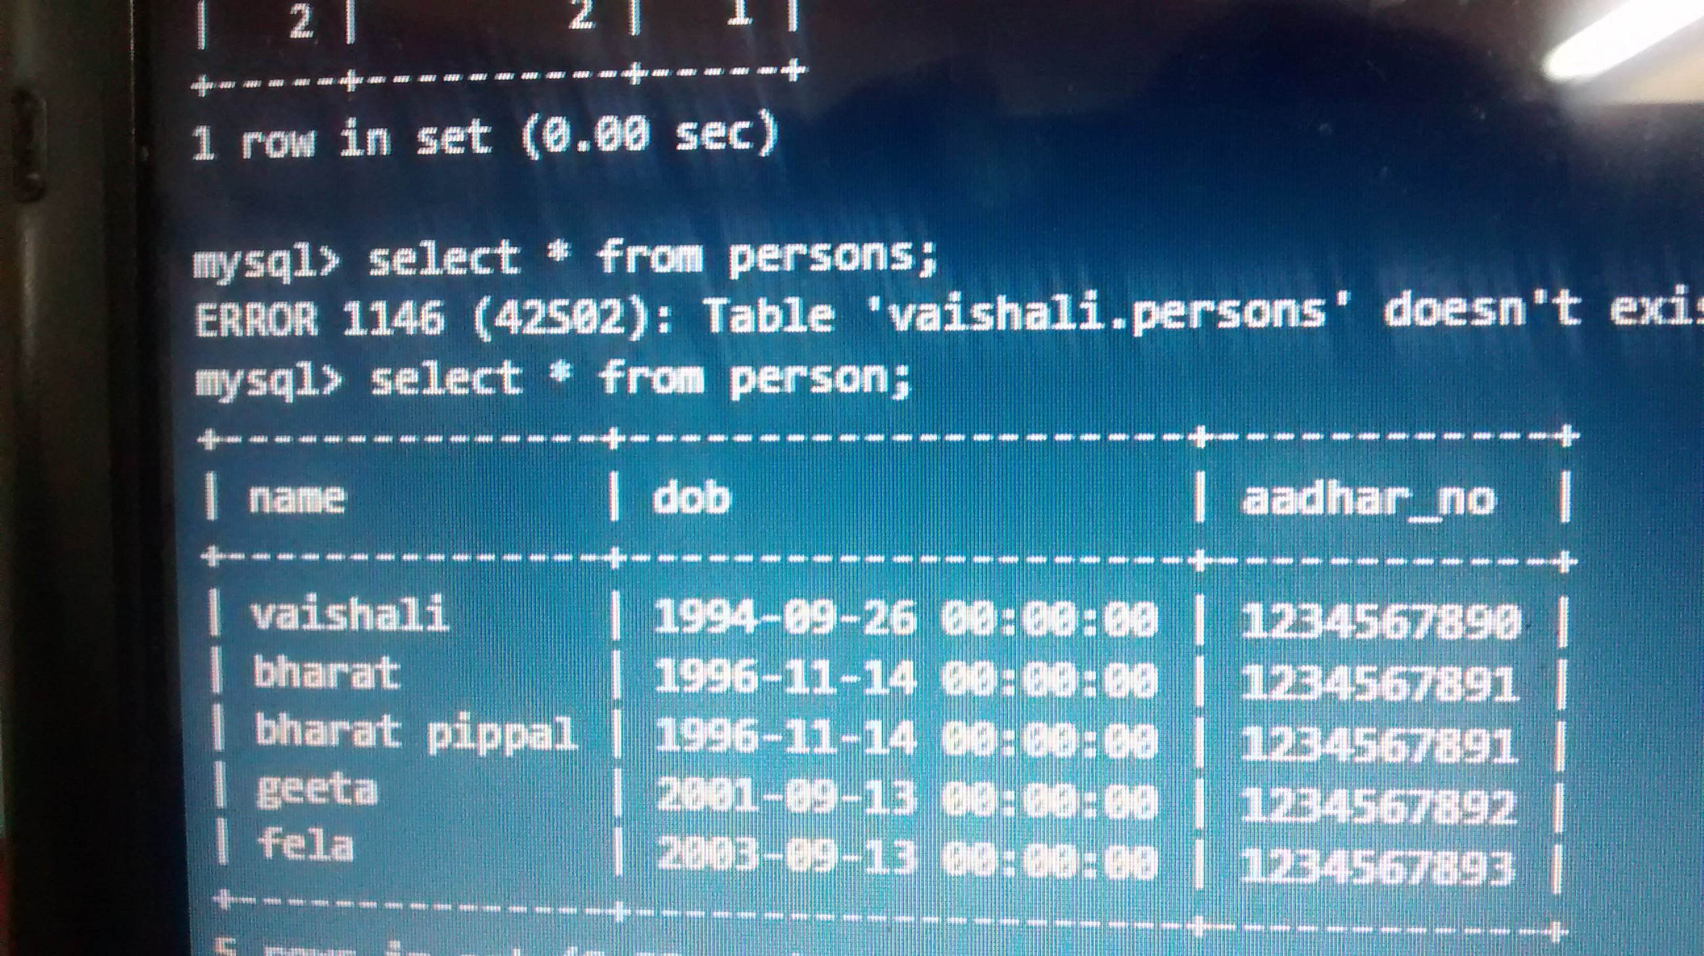

Slide 7
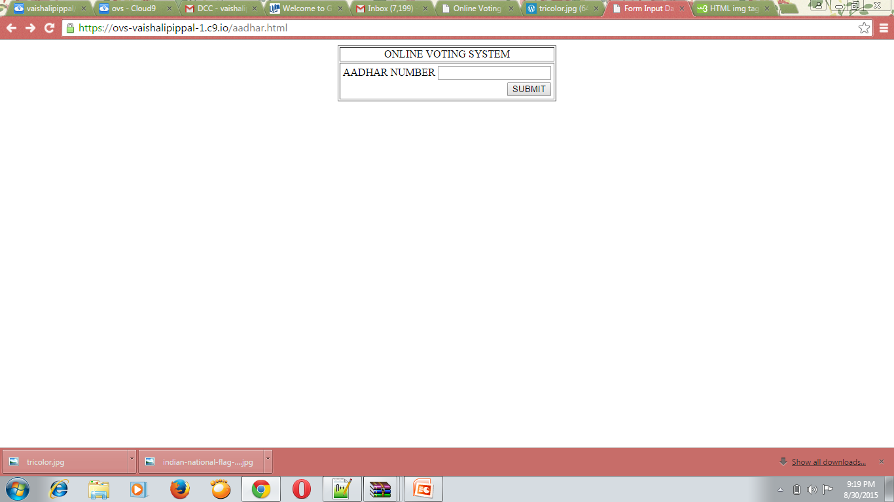

Slide 8
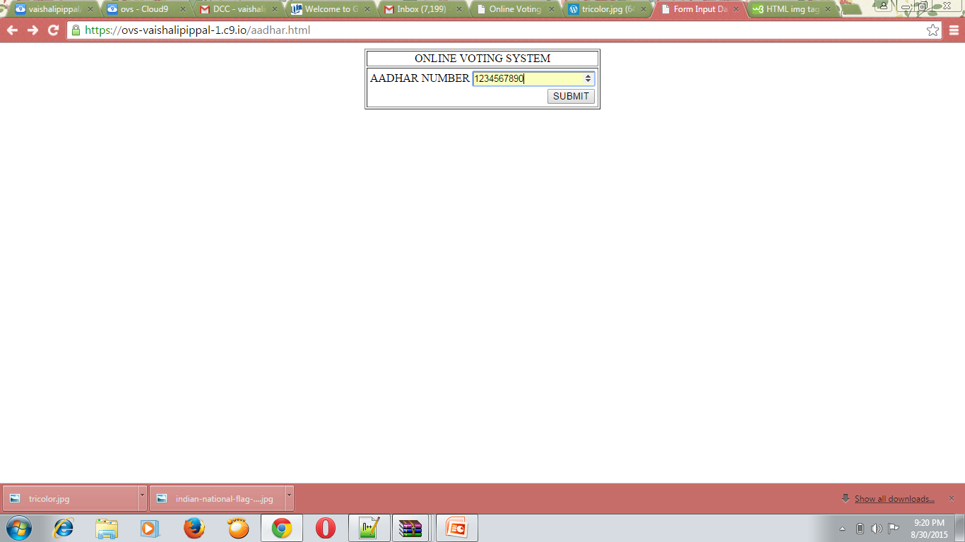

Slide 9
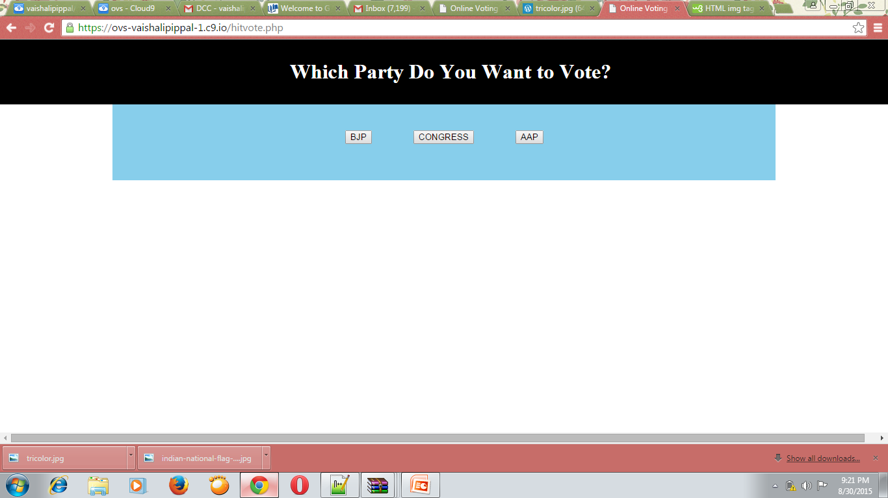

Slide 10
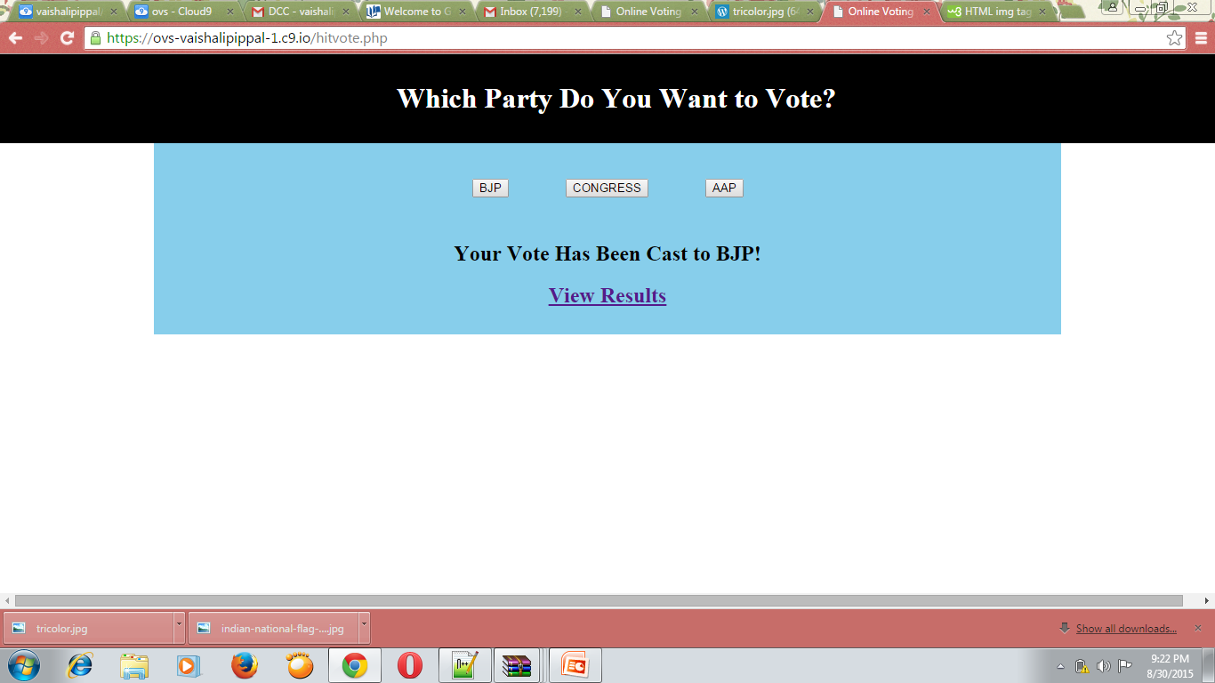

Slide 11
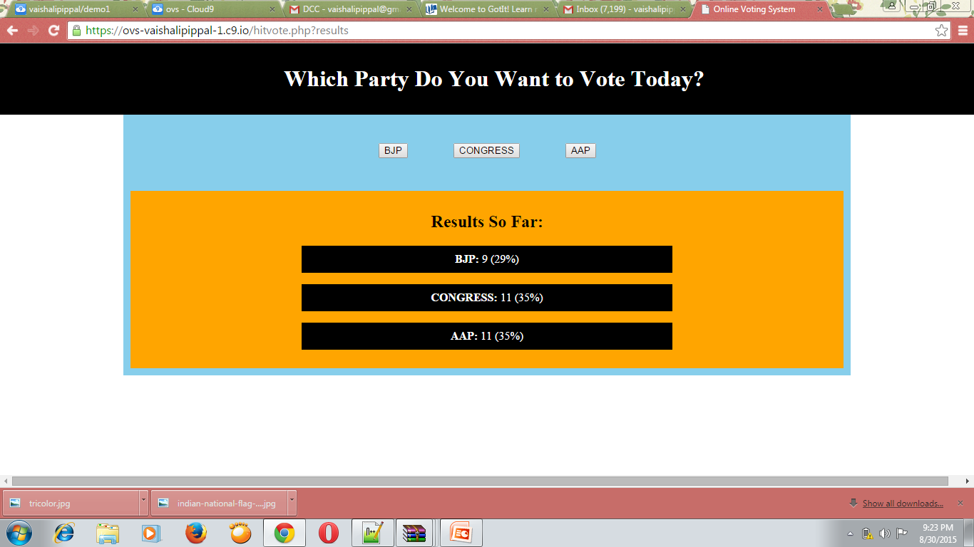

Slide 12
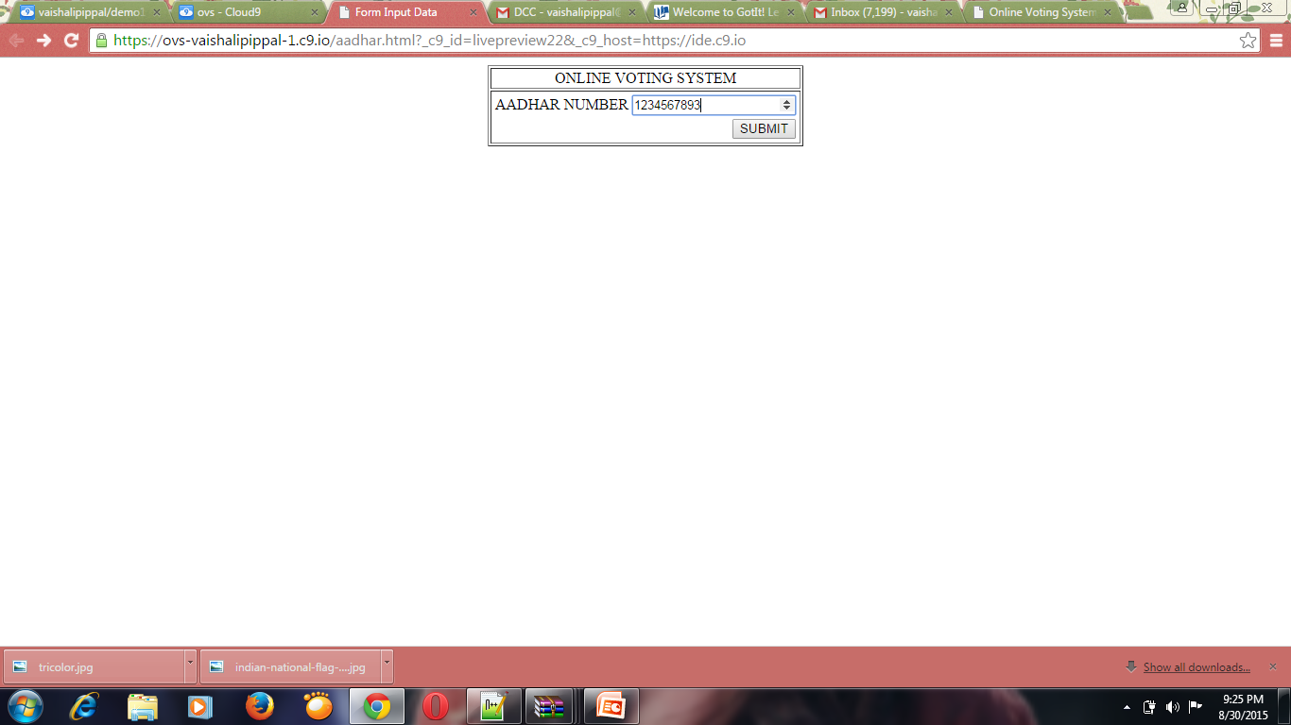

Slide 13
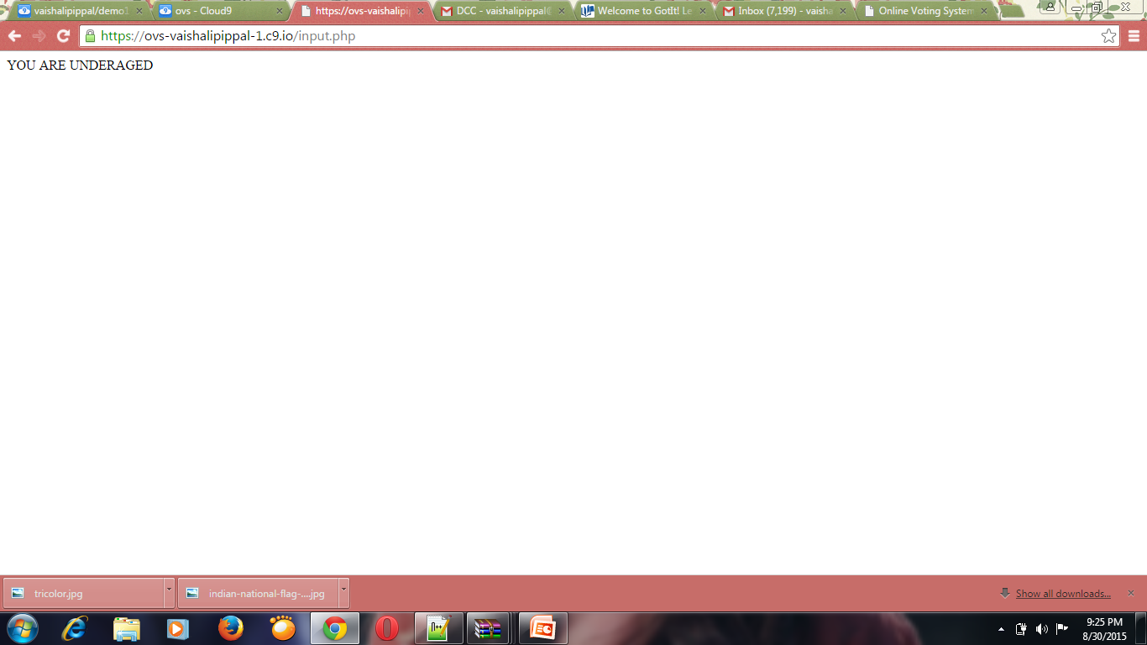

Slide 14
THANK
YOU

